Slide 1
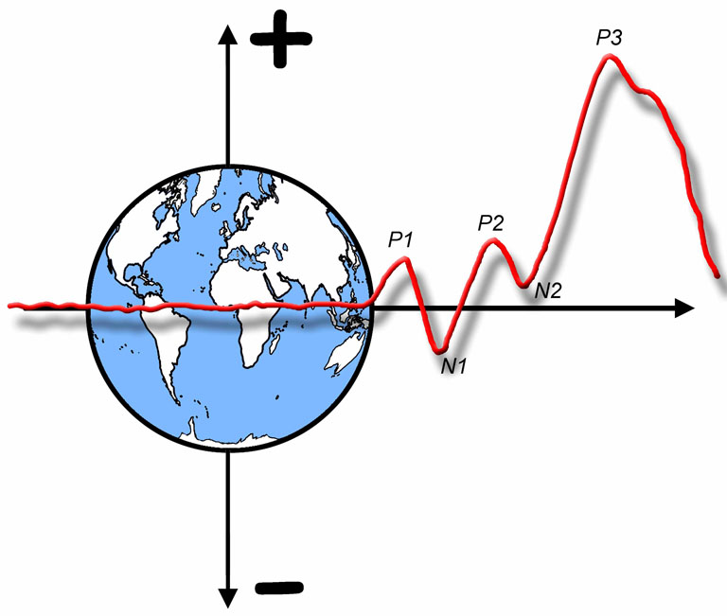

The ERP Boot Camp
Time-Frequency Analysis

Slide 2
Conventional Averaging
Assumption: The timing of the ERP signal is the same on each trial
The stimulus might elicit oscillations that vary in phase or onset time from trial to trial
These will disappear from the average
Time-frequency analysis can recover these oscillations
Notes:
Adapted from Figure 1 in Bastiaansen, M., Mazaheri, A., & Jensen, O. (2012). Beyond ERPs: Oscillatory neuronal dynamics. In S. J. Luck & E. S. Kappenman (Eds.), The Oxford Handbook of ERP Components (pp. 31-49). New York: Oxford University Press. © Oxford University Press

Slide 3
Time-Frequency Analysis
Notes:
Adapted from Figure 8.9 in Luck, S.J. (2014). An Introduction to the Event-Related Potential Technique, Second Edition. Cambridge, MA: MIT Press. © MIT Press.
This material may be used for nonprofit research and education purposes only, and it may not be reprinted or distributed in any form including print and electronic forms.

Slide 4
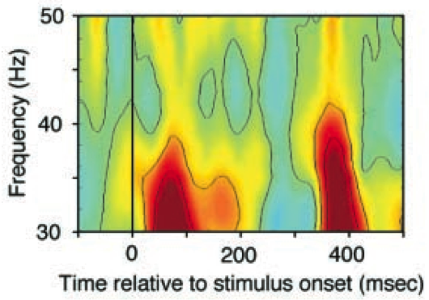
Time-Frequency Analysis
Each slice shows the time course of activity for a single frequency
Intensity is represented by color
Notes:
Left portion reprinted from Csibra, G., Davis, G., Spratling, M. W., & Johnson, M. H. (2000). Gamma oscillations and object processing in the infant brain. Science, 290(5496), 1582-1585. Reprinted with permission from AAAS.
Other content © S. J. Luck. All Rights Reserved. May be used for nonprofit educational purposes if this copyright notice is included. Permission must be obtained from the copyright holder(s) for any other use.

Slide 5
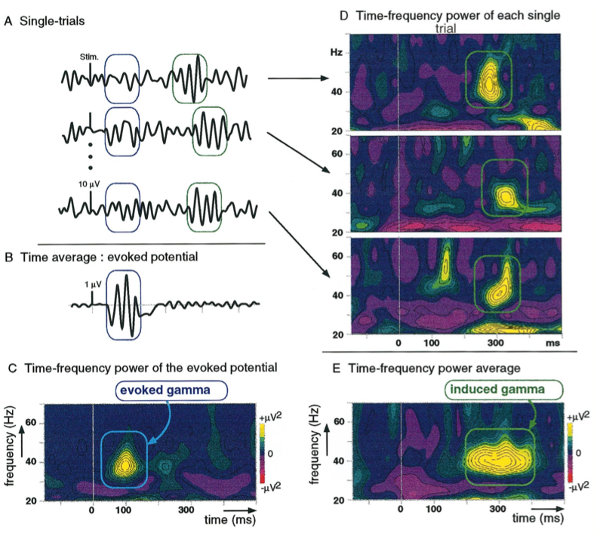
Tallon-Baudry & Bertrand (1999)
Notes:
Reprinted from Tallon-Baudry, C., Bertrand, O., Delpuech, C., & Pernier, J. (1996). Stimulus specificity of phase-locked and non-phase-locked 40 Hz visual responses in humans. Journal of Neuroscience, 16, 4240-4249. Reprinted with permission from The Journal of Neuroscience. This material may be used for nonprofit research and education purposes only, and it may not be reprinted or distributed in any form including print and electronic forms.

Slide 6
How to Do It
If you wanted to measure the amount of 10-Hz activity in an ERP waveform, how would you do it?
What would the frequency response function be?
Gain = 1.0 at 10 Hz and 0 for every other frequency
What would the impulse response function be?
Inverse Fourier transform of frequency response function
Inverse Fourier Transform
Fourier Transform
10-Hz Sine Wave
(Infinite Duration)
10 Hz
Notes:
© S. J. Luck. All Rights Reserved. May be used for nonprofit educational purposes if this copyright notice is included. Permission must be obtained from the copyright holder(s) for any other use.

Slide 7
How to Do It
How could you give the 10-Hz sine wave some temporal precision (so that you could measure amount of 10 Hz in different latency ranges)?
Solution 1: Limit time range of sine wave to 1 cycle
Problem: We have multiplied the sine wave by a boxcar, which creates poor precision in the frequency domain
Inverse Fourier Transform
(Ugly!)
Fourier Transform
One cycle of
10-Hz Sine Wave
10 Hz
Notes:
© S. J. Luck. All Rights Reserved. May be used for nonprofit educational purposes if this copyright notice is included. Permission must be obtained from the copyright holder(s) for any other use.

Slide 8
How to Do It
Solution 2: Gaussian x Sine = Gabor function
Optimal tradeoff between time and frequency
Fourier Transform
Inverse Fourier Transform
10-Hz Gabor Function
Notes:
© S. J. Luck. All Rights Reserved. May be used for nonprofit educational purposes if this copyright notice is included. Permission must be obtained from the copyright holder(s) for any other use.

Slide 9
How to Do It
Solution 2: Gaussian x Sine = Gabor function
Optimal tradeoff between time and frequency
Original Waveform
Filtered Waveform
Note the temporal imprecision of the filter
10-Hz Gabor Function
Notes:
© S. J. Luck. All Rights Reserved. May be used for nonprofit educational purposes if this copyright notice is included. Permission must be obtained from the copyright holder(s) for any other use.

Slide 10
How to Do It
Solution 2: Gaussian x Sine = Gabor function
Optimal tradeoff between time and frequency
Need cosine component as well
Original Waveform
Filtered Waveform
Note the temporal imprecision of the filter
10-Hz Gabor Function
Notes:
© S. J. Luck. All Rights Reserved. May be used for nonprofit educational purposes if this copyright notice is included. Permission must be obtained from the copyright holder(s) for any other use.

Slide 11
How to Do It
Solution 2: Gaussian x Sine = Gabor function
Optimal tradeoff between time and frequency
Need cosine component as well
Combine sine- and cosine-filtered waveforms to provide a phase-independent measure of amplitude at each time point
Original Waveform
Filtered Waveform
Note the temporal imprecision of the filter
10-Hz Gabor Function
Notes:
© S. J. Luck. All Rights Reserved. May be used for nonprofit educational purposes if this copyright notice is included. Permission must be obtained from the copyright holder(s) for any other use.

Slide 12
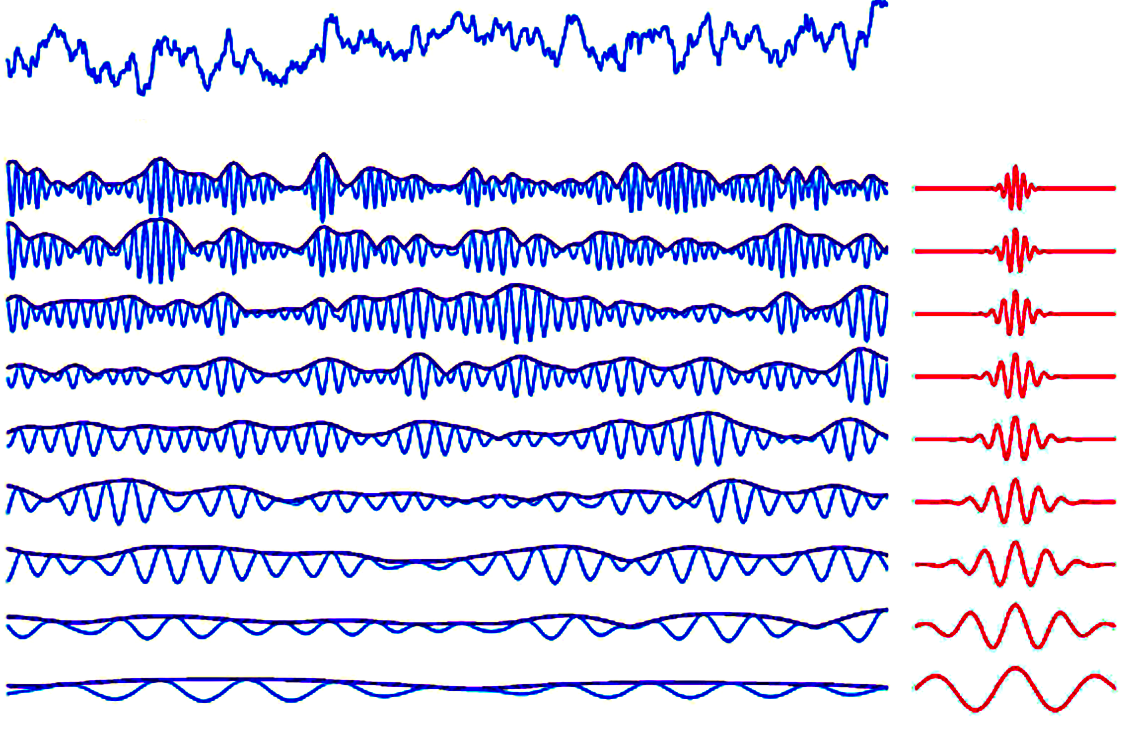
Raw EEG
Bandpass-Filtered EEG and Amplitude Envelope
Gabor Filters
Combine sine- and cosine-filtered waveforms to provide a phase-independent measure of amplitude at each time point (EEG envelope)
From R.T. Knight
Notes:
Figure courtesy of Robert T. Knight
© S. J. Luck. All Rights Reserved. May be used for nonprofit educational purposes if this copyright notice is included. Permission must be obtained from the copyright holder(s) for any other use.

Slide 13
Time-Frequency Analysis
Each slice is the application of one Gabor function (sine and cosine) at the specified frequency, with amplitude coded by color
The family of Gabor functions is a Morlet wavelet family
Notes:
Left portion reprinted from Csibra, G., Davis, G., Spratling, M. W., & Johnson, M. H. (2000). Gamma oscillations and object processing in the infant brain. Science, 290(5496), 1582-1585. Reprinted with permission from AAAS.
Other content © S. J. Luck. All Rights Reserved. May be used for nonprofit educational purposes if this copyright notice is included. Permission must be obtained from the copyright holder(s) for any other use.

Slide 14
Time-Frequency Interpretation
Fundamental Principle #1: Power in a given frequency band is not evidence of an oscillation in that band
Transient, non-oscillating activity always produces power in some frequency bands
Frequency-based analyses assume that the waveform is composed of oscillations
Other evidence of oscillation is necessary
Power at 5 Hz is not evidence of an oscillation at 5 Hz
Fourier Transform
Inverse Fourier Transform
5
Notes:
© S. J. Luck. All Rights Reserved. May be used for nonprofit educational purposes if this copyright notice is included. Permission must be obtained from the copyright holder(s) for any other use.

Slide 15
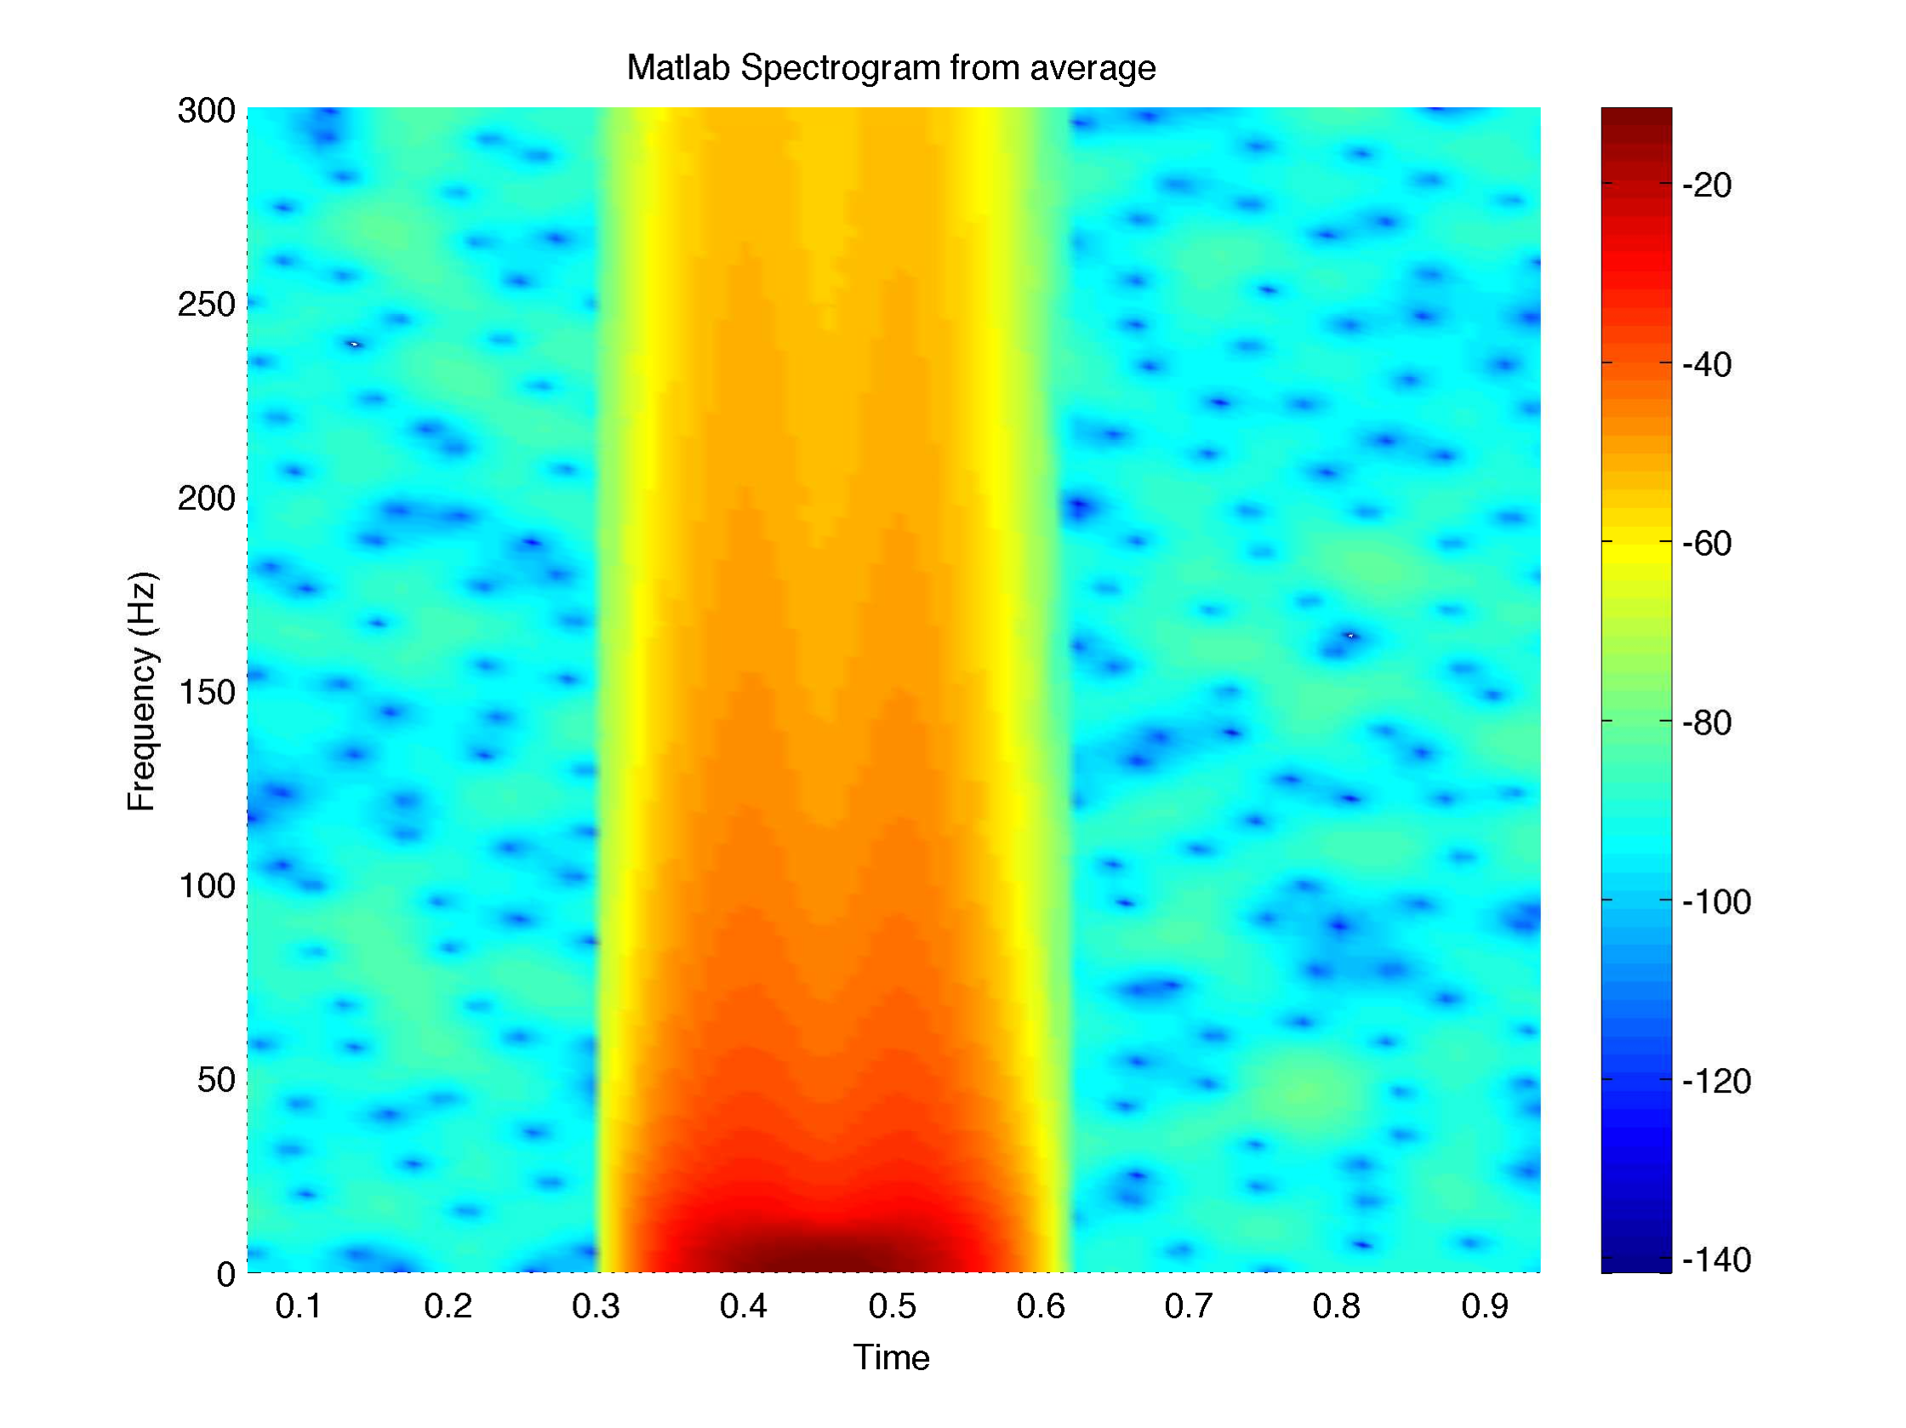
Typical time-frequency pattern for transient response
Triangular shape because filtering function is narrower in time at higher frequencies (with Morlet wavelet)
Power drops as frequency increases
Notes:
© S. J. Luck. All Rights Reserved. May be used for nonprofit educational purposes if this copyright notice is included. Permission must be obtained from the copyright holder(s) for any other use.

Slide 16
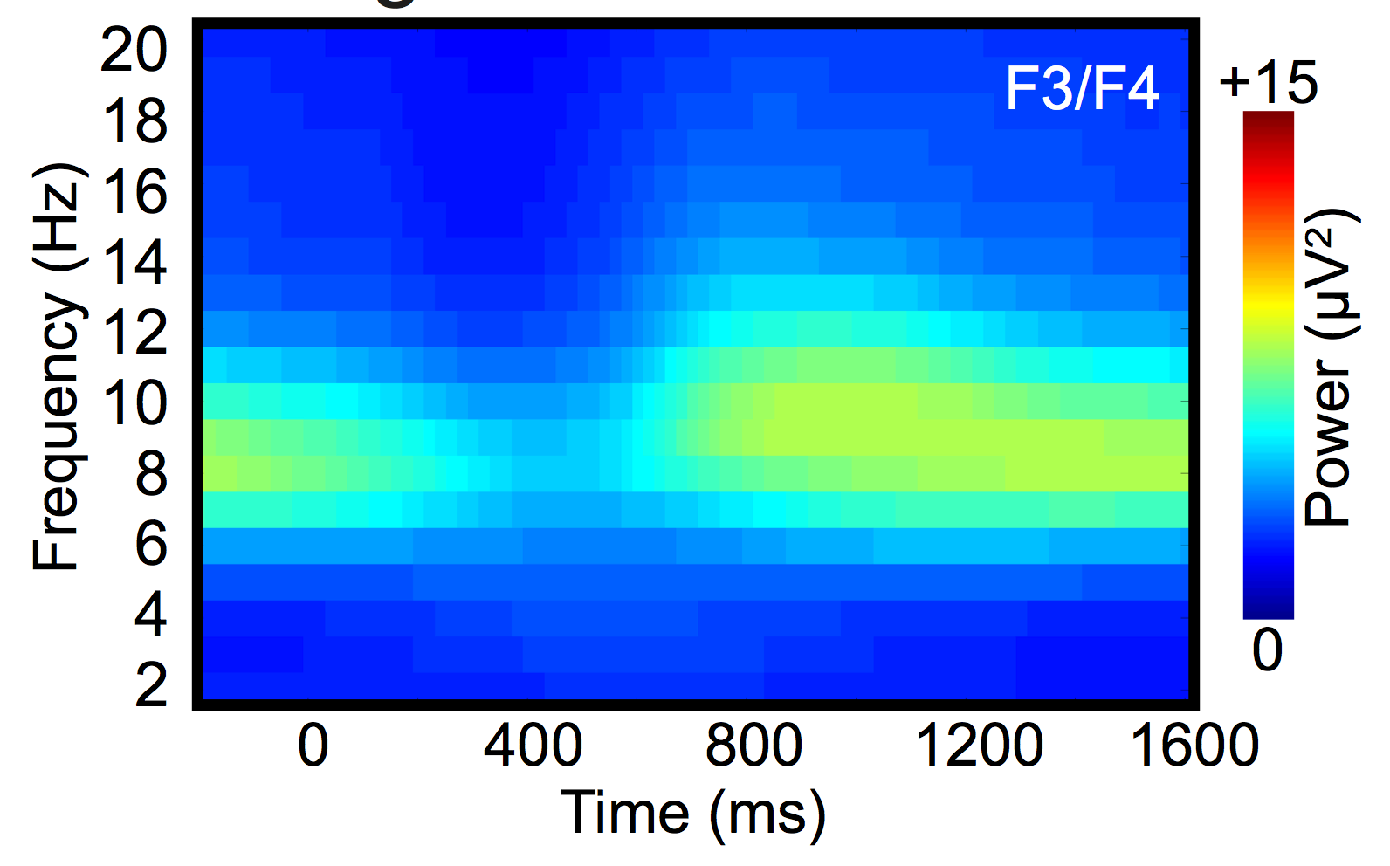
Typical time-frequency pattern for true oscillation
Yes: narrow band with no low frequencies
Sawaki et al. (in preparation)
Notes:
© S. J. Luck. All Rights Reserved. May be used for nonprofit educational purposes if this copyright notice is included. Permission must be obtained from the copyright holder(s) for any other use.

Slide 17
Time-Frequency Interpretation
Rule of Thumb: In most cases, a broad band of power means that it is not a true oscillation
Researchers must show absence of power at low frequencies before concluding that an oscillation was present
Narrow bands of power are usually genuine oscillations
Impossible to know whether these are oscillations without seeing lower frequencies
Notes:
Image reprinted from Csibra, G., Davis, G., Spratling, M. W., & Johnson, M. H. (2000). Gamma oscillations and object processing in the infant brain. Science, 290(5496), 1582-1585. Reprinted with permission from AAAS.
Other content © S. J. Luck. All Rights Reserved. May be used for nonprofit educational purposes if this copyright notice is included. Permission must be obtained from the copyright holder(s) for any other use.

Slide 18
What is an oscillation?
“Oscillation is the repetitive variation, typically in time, of some measure about a central value or between two or more different states.” (Wikipedia)
“Neural oscillations refers to rhythmic or repetitive neural activity in the central nervous system.” (Wikipedia)
Is something actually repeating in the brain 5 times per second?
Fourier Transform
Inverse Fourier Transform
5
Notes:
© S. J. Luck. All Rights Reserved. May be used for nonprofit educational purposes if this copyright notice is included. Permission must be obtained from the copyright holder(s) for any other use.

Slide 19
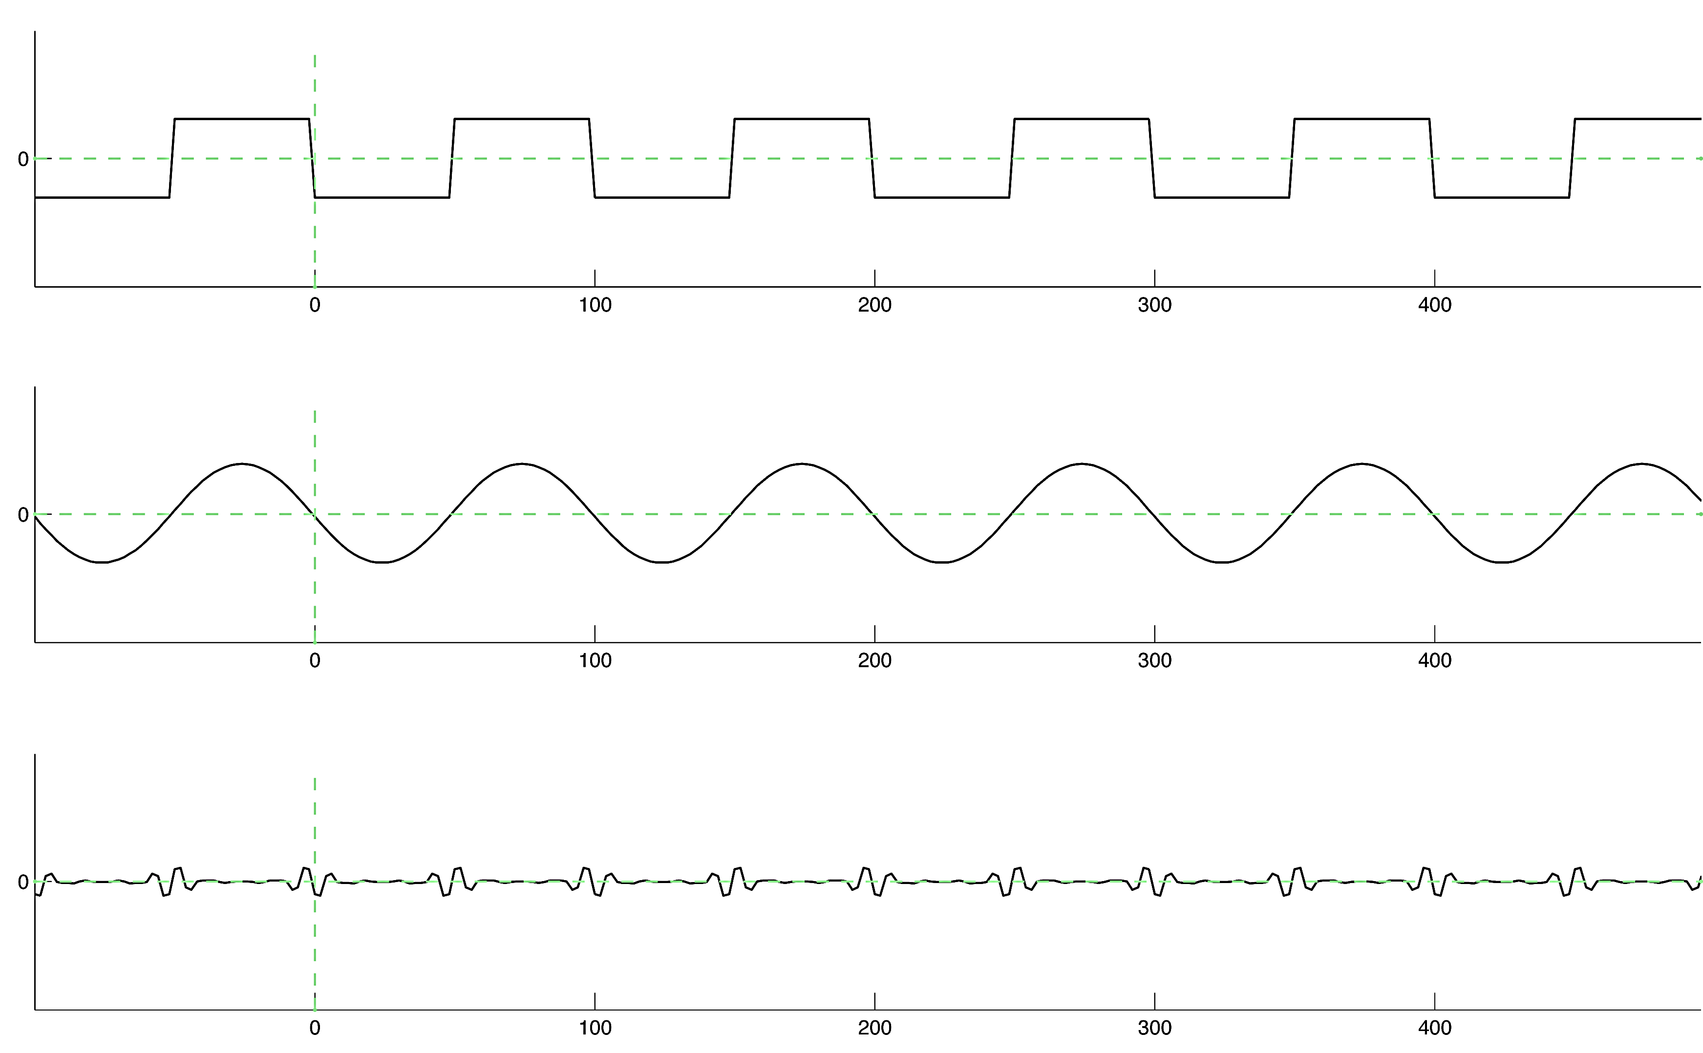
Phase-Amplitude Coupling?
For a detailed analysis, see Kramer, Tort, & Kopell (2008, J Neuroscience Methods)
Notes:
© S. J. Luck. All Rights Reserved. May be used for nonprofit educational purposes if this copyright notice is included. Permission must be obtained from the copyright holder(s) for any other use.

Slide 20
General Advice
Go ahead and do time-frequency analyses
You can see brain activity that is invisible in conventional averages
Just be very careful about the conclusions you draw about “oscillations”
Notes:
© S. J. Luck. All Rights Reserved. May be used for nonprofit educational purposes if this copyright notice is included. Permission must be obtained from the copyright holder(s) for any other use.

Slide 21
Inter-Trial Phase Coherence
Question: Is phase consistent across trials?
Fit sine wave (or Gabor) at a particular frequency (e.g., 40 Hz) to the EEG at a given electrode on single trials
Is the phase similar across trials?
Phase
on Trial 1
Phase
on Trial 2
Phase
on Trial N
Phase
over all trials
(coherence)
Phase
over all trials
(no coherence)
Notes:
© S. J. Luck. All Rights Reserved. May be used for nonprofit educational purposes if this copyright notice is included. Permission must be obtained from the copyright holder(s) for any other use.

Slide 22
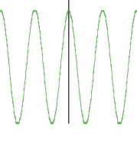
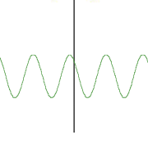
Inter-Electrode Phase Coherence
Question: Are distant brain areas synchronized?
Look for evidence that phase of an oscillation is similar at distant electrode sites
Fit sine wave (or Gabor) at a particular frequency (e.g., 40 Hz) to the EEG at two sites on single trials
Is the difference in phase between the two sites similar across trials or random across trials?
Trial 1
Phase Δ
on Trial 1
Electrode A
Electrode B
Notes:
© S. J. Luck. All Rights Reserved. May be used for nonprofit educational purposes if this copyright notice is included. Permission must be obtained from the copyright holder(s) for any other use.

Slide 23
Inter-Electrode Phase Coherence
Question: Are distant brain areas synchronized?
Look for evidence that phase of an oscillation is similar at distant electrode sites
Fit sine wave (or Gabor) at a particular frequency (e.g., 40 Hz) to the EEG at two sites on single trials
Is the difference in phase between the two sites similar across trials or random across trials?
Phase Δ
on Trial 1
Phase Δ
on Trial 2
Phase Δ
on Trial N
Phase Δ
over all trials
(coherence)
Phase Δ
over all trials
(no coherence)
Notes:
© S. J. Luck. All Rights Reserved. May be used for nonprofit educational purposes if this copyright notice is included. Permission must be obtained from the copyright holder(s) for any other use.

Slide 24
Inter-Electrode Phase Coherence
Caution 1: Could be similarity in timing of transient events rather than similarity of oscillations
Caution 2: Phase coherence among nearby electrodes probably reflects volume conduction
Caution 3: The use of a common reference site will create artificial coherence
Cannot legitimately look at phase coherence in standard scalp EEG
Need to look at reference-free signals (“source waveforms,” current density waveforms, MEG waveforms, etc.)
Notes:
© S. J. Luck. All Rights Reserved. May be used for nonprofit educational purposes if this copyright notice is included. Permission must be obtained from the copyright holder(s) for any other use.

